Slide 1


RAMP: Resource-Aware Mapping for CGRAs
Shail Dave, Mahesh Balasubramanian, Aviral Shrivastava
Compiler Microarchitecture Lab,
Arizona State University

Slide 2
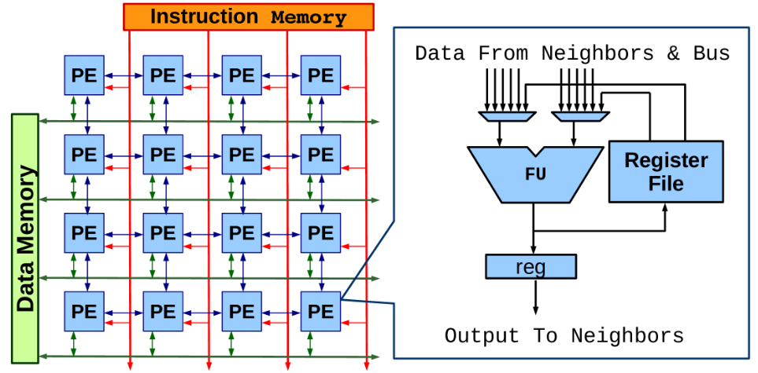
Coarse Grained Reconfigurable Array (CGRA)
An array of Processing Elements (PEs); each PE has ALU-like functional unit that works on an operation at every cycle.
Array configurations vary in terms of –
Array Size ► Reg. File Architectures
Functional Units ► Interconnect Network
Quick Facts
CGRAs can achieve power-efficiency of several 10s of GOps/Sec per Watt!
ADRES CGRA, upto 60 GOps/sec per Watt [IMEC, HiPEAC 2008]
HyCUBE, about 63 MIPS/mW [Karunaratne M. et al., DAC 2017]
Popular in Embedded Systems and Multimedia [Samsung SRP processor]

Slide 3
Mapping Loops on CGRAs
Modulo Schedule
B = 0;
for(i=0; i<1000; i++)
{
A = B - 4;
B = A + L;
C = A * 3
D = C + 7;
}
a
1
Iterative Modulo Scheduling
Each loop iteration is executed at II cycles [Bob Rau, MICRO 1994]
1
time
i=0
a:
b
c
2
1
a
b:
c:
d:
d
1
2
b
c
Software Pipelining
Operations from 2 different iterations execute simultaneously
Sample Loop
DDG
i=1
II = 2
4 operations to map on 2 PEs => minimum initiation interval (MII) is 2 cycles.
1
2
3
a
d
1x2 CGRA
The Code Generation Battle
The performance (loop execution time) critically depends on the mapping obtained by compiler
Mapping problem boils down to routing problem
In a temporal-spatial solution set, if all the dependent operations are placed on those PEs which can directly communicate the resultant values at time being, mapping (placement) is trivial.
Routing is needed when the dependent operations can be scheduled at a distant time, or operations cannot be mapped due to resource constraints.

Slide 4
What are the Various
Routing Strategies

Slide 5
Routing Data Dependency via PEs
Modulo Schedule (II = 3)
P&R
DDG
time
To achieve a mapping,
Need to route a → d
1
a
1
a
►
Insert a routing operation Place it on an empty PE slot
(EMS[1], EPIMap[2])
2
2
b
a_{r}
b
3
c
3
c
a_{rr}
1
d
4
a
d
1
2
1x2 CGRA
[1] H. Park et al., Edge-centric modulo scheduling for coarse-grained reconfigurable architectures. In PACT, 2008.
[2] M. Hamzeh et al., Epimap: using epimorphism to map applications on cgras. In DAC, 2012.
Notes:
1.5-2

Slide 6
Routing Data Dependency via Registers
Modulo Schedule (II = 2)
DDG
time
P&R
1
a
a⁰
1
a
2
b
2
a⁰
b
1
c
3
a⁰
c
d
a
2
a¹
d
a⁰
R1
R1
4
a¹
b
1
2
R2
R2
[3] L. Chen et al., Graph minor approach for application mapping on cgras. ACM TRETS, 2014.
[4] M. Hamzeh et al., Regimap: Register-aware application mapping on cgras. In DAC, 2013.

Slide 7
Routing Data Dependency via Memory
Modulo Schedule (II = 3)
P&R
DDG
time
1
a
1
a
2
2
b
S_{a}
b
3
c
3
c
L_{a}
1
d
4
a
d
1
2
1x2 CGRA
[5] S. Yin et al., Memory-aware loop mapping on coarse-grained reconfigurable architectures. IEEE TVLSI, 2016.

Slide 8
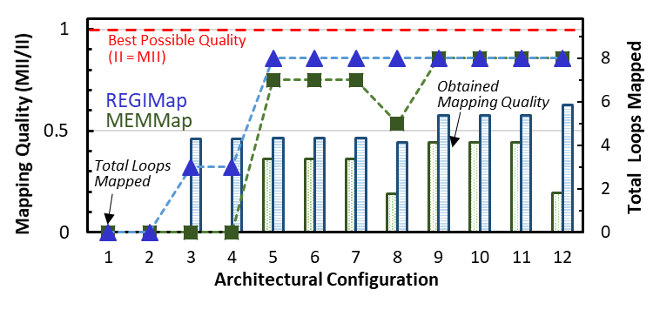
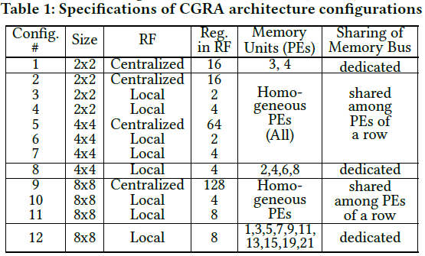
Analyzing Impact of Ad-hoc Routing Strategies
For the top performance-critical loops from 8 MiBench benchmarks, previous techniques failed to obtain mappings for almost all loops, when highly constrained by the resources.
The mapping quality obtained is far from the best possible mapping (II = MII), even when the target CGRA has higher resources (including manual attempts to achieve better mapping).

Slide 9
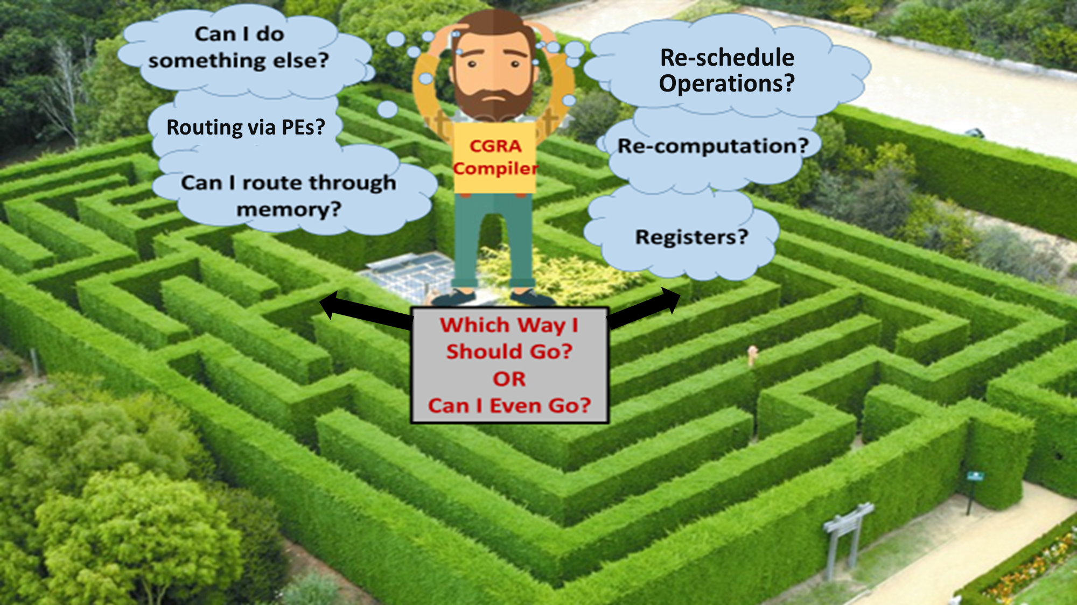
CGRA Code Generation Maze

Slide 10
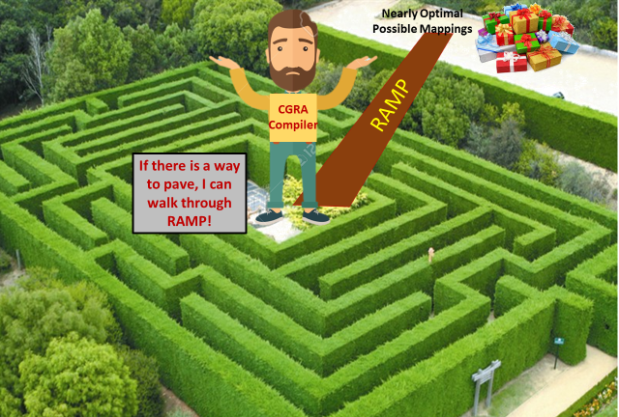
Valid mappings (with
Nearly optimal Quality)

Slide 11
RAMP: Resource-Aware Mapping
a
Mapping Attempt (II = 4)
time
i
b
t
a
2
c
Need to Route
Initially Route All Dependencies
Through Direct PE Communication
?
t+1
b
d
e
1
t+2
c
DDG
t+3
d
e
1
R1
2
R1
t+4
a
1x2 CGRA

Slide 12
RAMP: Resource-Aware Mapping
a
Mapping Attempt (II = 4)
time
i
b
t
a
a^{i}
e^{i-1}
2
c
Initially Route All Dependencies
Through Direct PE Communication
And via Registers
t+1
b
a^{i}
e^{i-1}
d
e
1
t+2
c
a^{i}
DDG
e^{i-1}
t+3
d
a^{i}
e
e^{i}
1
R1
2
R1
t+4
a
1x2 CGRA
a^{i+1}
e^{i}

Slide 13
RAMP: Resource-Aware Mapping
a
a
Mapping Attempt (II = 4)
time
i
i-1
b
b
t
a
a^{i}
e^{i-1}
b → e might be routed by
Spilling to memory
Distributed Registers
PEs
2
c
2
c
b_{r}
t+1
b
a^{i}
e^{i-1}
d
e
d
e
1
1
t+2
c
a^{i}
b_{r}
DDG
Modified
DDG
e^{i-1}
t+3
d
a^{i}
e
e^{i}
1
R1
2
R1
t+4
a
1x2 CGRA
a^{i+1}
e^{i}

Slide 14
RAMP: Resource-Aware Mapping
Mapping Attempt (II = 4)
a
a
time
i
i-1
b
L_{d}
b
d^{i} → c^{i-2} might be routed by
Spilling to memory
Distributed Registers
PEs
t
a
a^{i}
S_{d}
e^{i-1}
2
c
b_{r}
c
b_{r}
t+1
b
a^{i}
l_{d}
e^{i-1}
d
e
d
e
1
1
S_{d}
t+2
b_{r}
DDG
Modified
DDG
c
a^{i}
e^{i-1}
Mapping is Combination of:
- Routing via PEs
- Routing via Registers
- Spilling to Memory
II = 4
t+3
d
a^{i}
e
e^{i}
1
R1
2
R1
t+4
a
S_{d}
e^{i}
a^{i+1}
1x2 CGRA

Slide 15
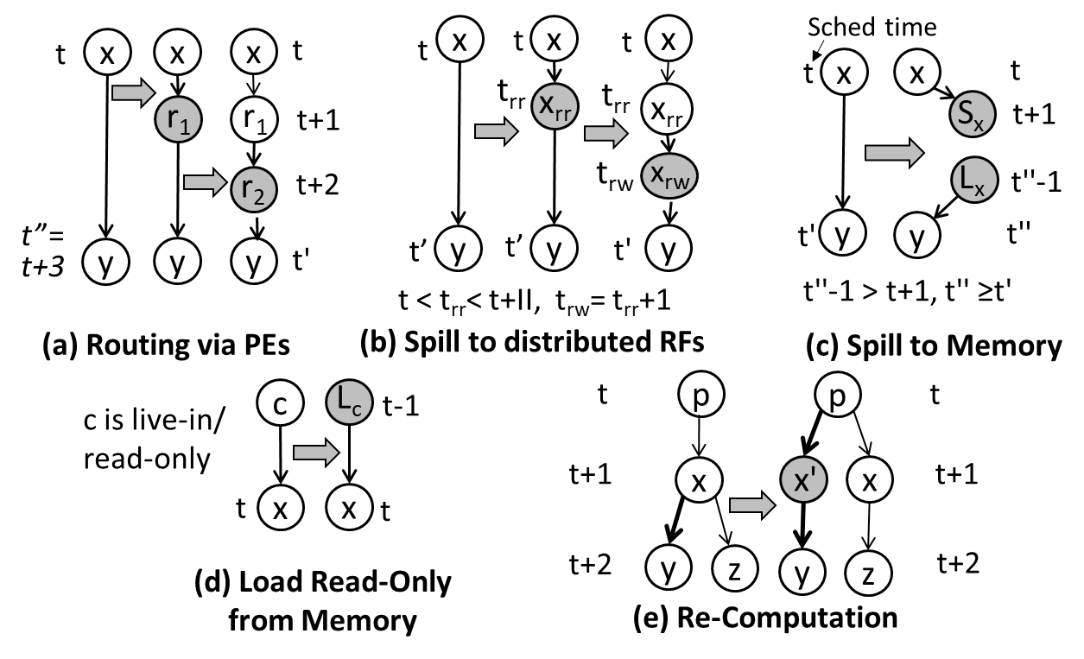
Selecting a Routing Alternative
Failure Analysis
Dependent operations are scheduled at distant time; managing the data with large lifetime in registers is not possible
Route by PEs, Spill to memory/distributed RFs
Dependent operation is a live value, cannot be managed in the register.
Manage live value in the memory
Dependent operations are scheduled at the consequent time; routing is not possible due to limited interconnect/unavailability of free PEs
Re-compute, Route by a PE, Re-schedule
Graph Modification and Rescheduling

Slide 16
RAMP Enables Spilling to Distributed RFs
Based on the distant schedule time of dependent operations, RAMP determines number of distributed registers required.
Before the source operation (e) of the next iteration (e^{i+1}) over-writes the value, insert a RF-read operation e_{rr}.
If the destination operation (a^{i}) is scheduled far than e_{wr}, insert a RF-write operation.
P&R should ensure that operations e_{rr} and e_{wr} are mapped onto the PEs that don’t share RF.
time
i
a
t
f
e^{i-1}
a
e^{i-2}
2
b
g
g
t+1
b
e^{i-1}
e^{i-2}
c
t+2
e_{rr}
e^{i-1}
c
e^{i-2}
d
II = 5
e
h
t+3
d
e^{i-1}
e_{rw}
e^{i-1}
f
t+4
e
e^{i}
h
e^{i-1}
t+5
f
e^{i}
a
e^{i-1}
1
R1
2
R1

Slide 17
Experimental Setup
Benchmarks
MiBench suite [Guthaus et al., IEEE WWC 2001] (top performance critical loops)
Compilation
CCF: CGRA Compilation Framework (LLVM 4.0 [Lattner et al., CGO 2004] as foundation)
Optimization level 3
Simulation
Cycle-Accurate CCF-Simulator (based on gem5 [Binkert et al., SIGARCH Comp. Arch. News 2001])
CGRA modeled as a separate core coupled with ARM Cortex-like processor core
PEs connected in a 2D torus, perform fixed-point computations
CGRA accesses 4 kB data memory and 4 kB instruction memory
Techniques Evaluated
Register-aware mapping - REGIMap [Hamzeh et al., DAC 2012]
Memory-aware mapping - MEMMap [Yin et al., IEEE TVLSI 2016]
Resource-aware mapping - RAMP

Slide 18
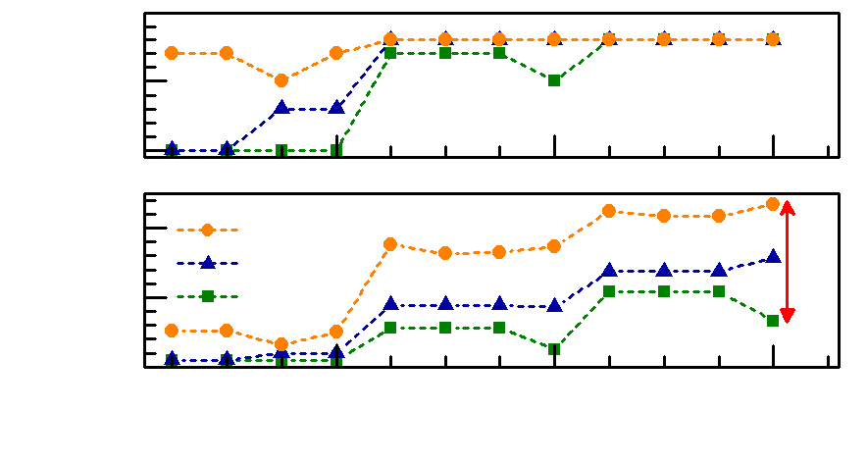
RAMP Improves CGRA’s Acceleration Capability by 2.13×
10
With systematic resource exploration, RAMP achieved better mapping, outperforming state-of-the-art.
It spills to memory and/or exploits the distributed registers, when the resources are limited.
Generated mapping features combination of various routing strategies to route different data dependencies.
Scaled well with the availability of different architectural resources.
RAMP adapts to the needs of the application, flexibly exploring resources via the various routing strategies.
Total Loops Mapped
5
0
20
RAMP
REGIMap
10
MEMMap
Speedup
0
4
8
12
Architecture Configuration
Increase in
Architectural
Resources
RAMP accelerated loops by 23× as compared to sequential execution, and by 2.13× over REGIMap, and by 3.39× over MEMMap.

Slide 19
RAMP Achieves Nearly Best Possible Mapping
Higher the Better
0.91
Since RAMP systematically explored resources, it spilled data to memory only after using the available registers, minimizing routing operations
E.g. jpeg encoding
New routing strategy of utilizing distributed registers yielded better mappings for susan, adpcm etc.
sha
bitcount
susan_ smooth
adpcm _enc
gsm_ short
gsm_ long
jpeg _enc
adpcm _dec
geo mean
Mapping Quality for Config#7 (4x4CGRA_LRF4)
To map unmapped operations, RAMP systematically explored the various routing strategies, instead of implicitly performing P&R in an ad-hoc manner.
RAMP was able to achieve better mapping with inserting less routing/memory operations.
With less operations to be mapped, RAMP observed same computational complexity as other clique-based mapping heuristics e.g. REGIMap or MEMMap.

Slide 20
Summary
The goodness of the obtained mapping is critically dependent on how efficiently the compiler can route the data dependencies.
Existing mapping techniques are unable to make good use of the routing resources. They first schedule the DDG and then attempt the P&R; routing is internal to P&R and is carried out in an ad-hoc manner. Hence,
Operations may not be mapped due to resource constraints, or
Obtain poor code quality.
RAMP models various routing strategies explicitly. It systematically and flexibly explores available architectural resources for routing the data dependencies.
Enables effective utilization of distributed registers and spilling to memory.
Failure analysis allows to systematically choose the routing alternatives to map a data dependency.
With comprehensive problem formulation, RAMP exploits heterogeneous architectural resources.
RAMP accelerated the top performance-critical loops of MiBench by 23× over a sequential execution, and by 2.13× over state-of-the-art techniques.

Slide 21

Thank you !

Slide 22
Additional Slides
Inefficiencies of the Mapping Heuristics with Ad-hoc Routing Strategies

Slide 23

Routing Data Dependency via PEs
Schedule (II = 3)
DDG
P&R
DDG
P&R
P&R
time
time
time
1
a
c
1
1
c
a
1
a
c
1
1
c
a
?
1
c
a
d
2
2
d
a_{r}
2
b
d
2
2
d
b
a_{r}
2
d
a_{r}
3
e
3
e
3
e
3
e
3
e
b
1
2
To achieve a mapping,
Need to route a → e
Since a_{r} is not rescheduled,
cannot route a → e
1x2 CGRA
►
Insert a routing operation Place it on an empty PE slot
(EMS[1], EPIMap[2])
►
Rescheduling (+ path-sharing) can enable a mapping.
[1] H. Park et al., Edge-centric modulo scheduling for coarse-grained reconfigurable architectures. In PACT, 2008.
[2] M. Hamzeh et al., Epimap: using epimorphism to map applications on cgras. In DAC, 2012.

Slide 24
Routing Data Dependency via Registers
GraphMinor[3] and REGIMap[4] allow routing dependency via registers.
To route the data dependency via register file of a PE, both the dependent operations (e and a) must be placed on the same PE.
Typically, for CGRA with local/distributed registers, target PE should have enough registers available to route the data dependency.
E.g., dependency e → a is routed only if the PE1 have 2 registers.
Challenge?
Routing dependency by efficiently utilizing distributed registers of different PEs.
time
a
i
t
a
e^{i-1}
2
b
g
t+1
b
e^{i-1}
g
c
t+2
c
e^{i-1}
d
t+3
?
d
e^{i-1}
e
h
t+4
e^{i-1}
e
e^{i}
h
f
t+5
i+1
a
f
1
R1
2
R1
[3] L. Chen et al., Graph minor approach for application mapping on cgras. ACM TRETS, 2014.
[4] M. Hamzeh et al., Regimap: Register-aware application mapping on cgras. In DAC, 2013.

Slide 25

Routing Data Dependency via Memory
MEMMap [5] statically determines to manage values with large lifetime in memory, avoiding the need of re-scheduling DDG
Challenges ?
Routing data dependency via memory (spilling) requires additional memory operations, and without re-scheduling the DDG, they might not be mapped!
With sufficient registers and PEs, such dependencies might be better managed via registers.
For a resource-constrained CGRA target, the variable value has to be spilled, even though its lifetime is less than the pre-set threshold.
time
i
a
l_{b}
1
1
c
b
2
?
a
s_{a}
d
e
3
c
b
s_{b}
4
d
e
f
5
f
l_{a}
g
6
g
1
R1
2
R1
[5] S. Yin et al., Memory-aware loop mapping on coarse-grained reconfigurable architectures. IEEE TVLSI, 2016.

Slide 26
Additional Slides
A High-Level Overview of RAMP

Slide 27
RAMP: Resource-Aware Mapping
Failure Analysis
Partition mapping in 3 sub problems:
Systematically explore routing strategies
Re-scheduling and
Place and Route
1
Routing
Strategy
2
3
Place & Route
Re-Schedule
Spill to Memory
Routing via PEs
and/or Registers
Spill to other distributed RFs
Load Read-Only Data From Memory
Route via PE
Change Schedule Time
Re- Compute
For example, we can choose to first map the DDG with routing via registers. Then, for any unmapped data dependency, explore different routing options.
For selected routing strategy, DDG is modified and re-scheduled.
Additional constraints: for spilling data to memory, a store must occur before a load!
Check whether the opted strategy(ies) routed the targeted data dependency.
For multiple strategies being successful, choose the one which maps more operations, and requires minimum PEs to map.
Take new modified and mapped graph, and try mapping remaining dependencies at targeted II.
If no strategy can route a dependency, need to increase II by 1, and start over.

